Slide 1


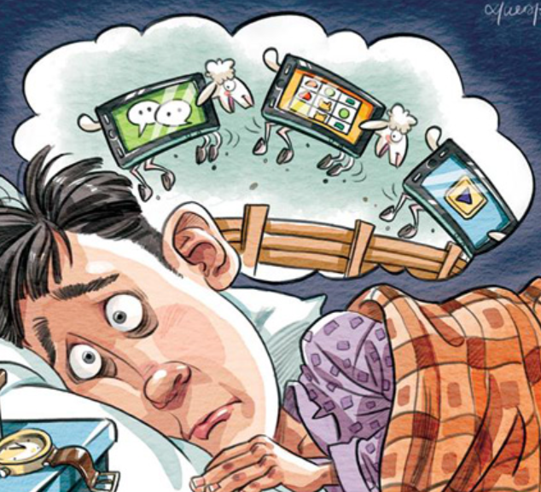

Cognitive Load Estimation
Mainak Chakraborty
2021idz8413
ELL88-IIT, DELHI
Source: http://en.people.cn/n3/2017/0321/c90000-9193030.html

Slide 2
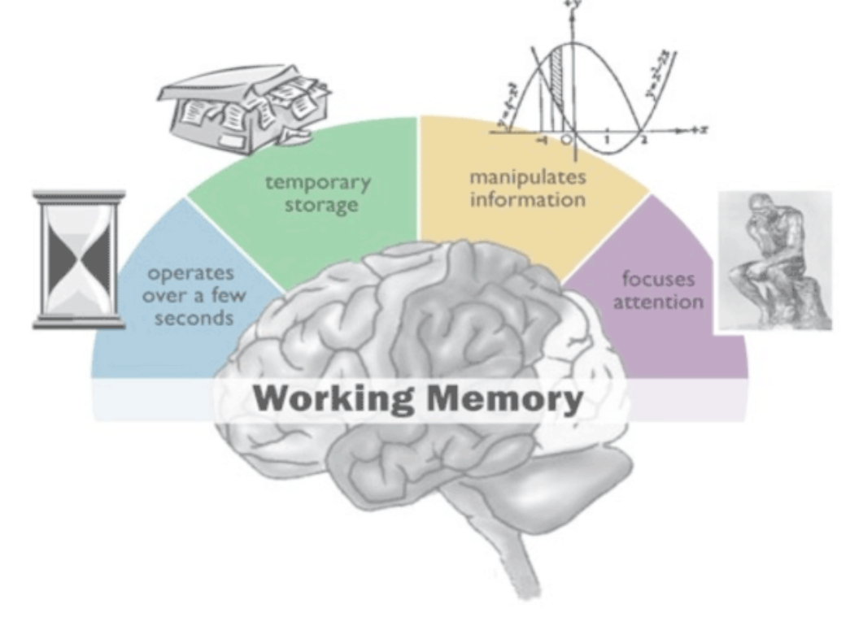
What is Cognitive Load?
Cognitive load is the amount of working memory being used, like the RAM in your computer, only for the human brain.
Three types of methods described here: non-invasive EEG, Eye tracking and smart wearables
NASA task load index(TLX), a set of questionnaires developed for estimating human mental workload [5].
Source: https://examinedexistence.com/what-is-working-memory-in-the-human-brain/
Notes:
These are mental demand, physical demand, own perception of performance, temporal demand, effort, and frustration

Slide 3
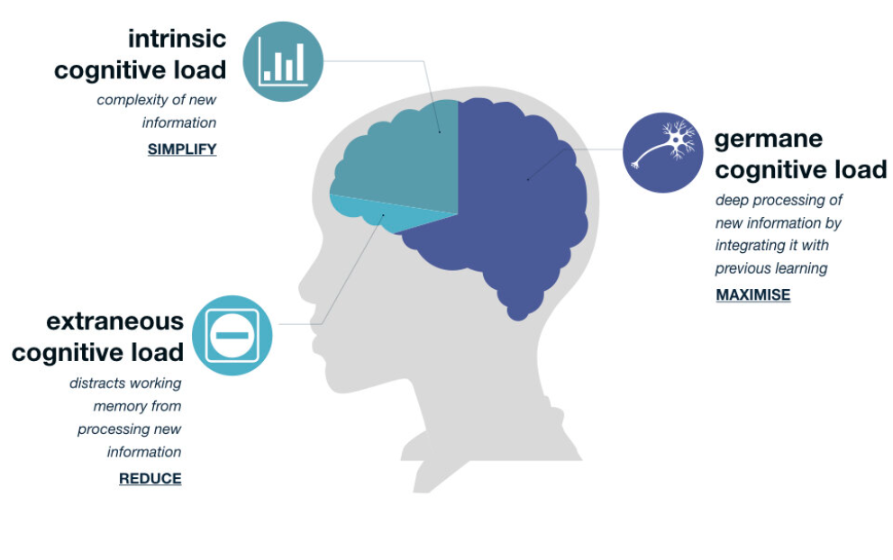
Three Types of Cognitive Load
The first is the ”intrinsic load,” the load that is associated with the task at hand
The second is the ”extraneous load,” the load imposed by the format of the stimulus (the User Interface of the experiment)
The third is the ”Germane,” which is the effort made to process the stimulus[3]
Source: https://mcdreeamiemusings.com/blog/2019/10/15/the-good-the-bad-and-the-can-be-ugly-the-three-parts-of-cognitive-load

Slide 4
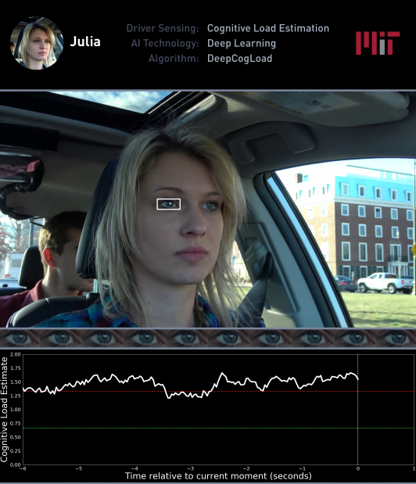
Stimulus Design
N-back tests(most common)
40,79,43
Essay comprehensive question
Easy, Medium, Hard tasks
IQ questions/Model design
Source: L. Fridman, B. Reimer, B. Mehler, W. T. Freeman, Cognitive load
estimation in the wild, in: Proceedings of the 2018 chi conference on
human factors in computing systems, 2018, pp. 1–9.

Slide 5
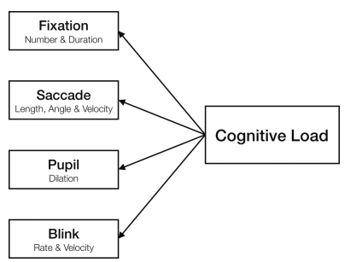
EYE TRACKING
1. Fixation: The constant maintenance of eye gaze in a particular location is defined as visual fixation.
2. Saccades : A saccadic movement is an instantaneous change in the eye between two fixation points.
3. Blinks : Blinking is a semi-voluntary activity due to the eyelid’s protractors and retractor muscles.
4. Pupil : The variation in pupil size can be due to most factors like age, humidity, and changes in lighting.
Source: Eye based Indicators for cognitive Load[1]

Slide 6
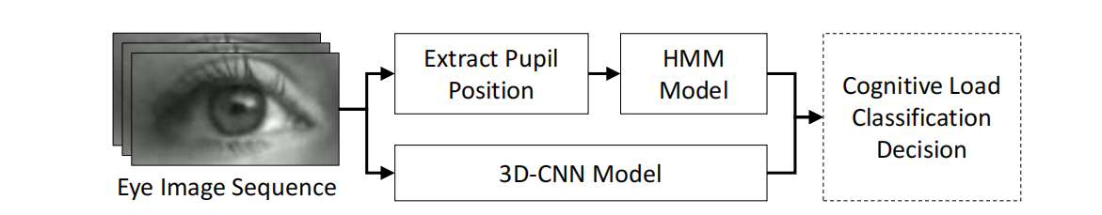
An example of eye tracking in the wild
Source: L. Fridman, B. Reimer, B. Mehler, W. T. Freeman, Cognitive load estimation in the wild, in: Proceedings of the 2018 chi conference on human factors in computing systems, 2018, pp. 1–9.

Slide 7
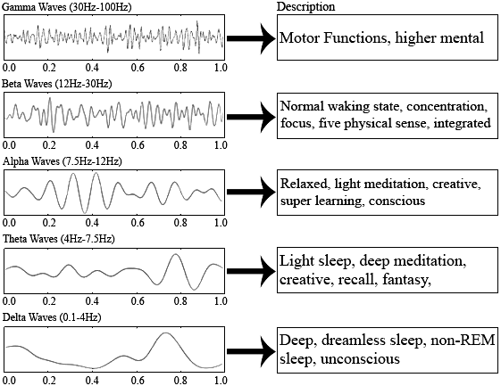
EEG Brain Waves
Source: V. Anand, S. Sreeja, D. Samanta, An automated approach for task
evaluation using eeg signals, arXiv preprint arXiv:1911.02966 (2019)

Slide 8
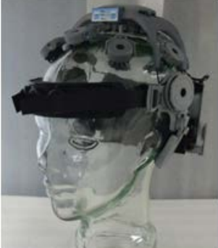
EEG
1. Data Collection :EEG data is generally collected through electrodes( 32/64 channels)
2. Data Preprocessing : bandpass filtering and Dc removal techniques [11].
3. Feature Extraction : FFT [24], DWT [25], entropy [26] are common features.
4. Feature Selection: (PCA) [27], (ICA)
5. Classifier: svm[27],KNN[27]
Figure: QUASAR Headset for EEG data collection[19]

Slide 9
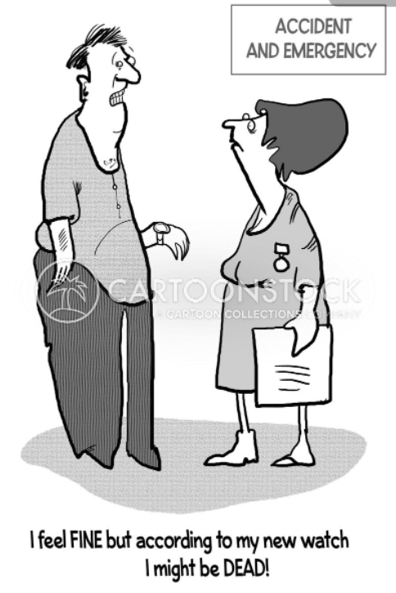
Smart Wearables
1. Data Collection : smart watches connected over mobiles phones.(R-R (or inter-beat) intervals, galvanic skin response (GSR), heart rate (HR), skin temperature (ST), barometer data, accelerometer and UV index data.)
2. Data Preprocessing : After this the data is either standardized [30] or min-max normalization [12].
3. Feature Extraction : Automatic time-series feature extraction [31].
4. Feature Selection: sequential backward floating search [30], Gini impurity [32],and maximal information coefficient [32]
5. Classifier: svm [32], logistic regression[32], and CNN [12]
Source: https://www.cartoonstock.com/directory/w/wearable_technologies.asp

Slide 10
Experiment- Open Source Dataset
The sampling rate is maintained at128 Hz.
Each of the eight subjects participated in the model building using Solid-works.
8 subject underwent three trials at 3 times a day.
Three categories of tasks (easy, medium, and hard) were given to the candidates. (3 classes)
The task involves building a Solid-works model using instruction. The dataset is divided into three folders, each based on difficulty.

Slide 11
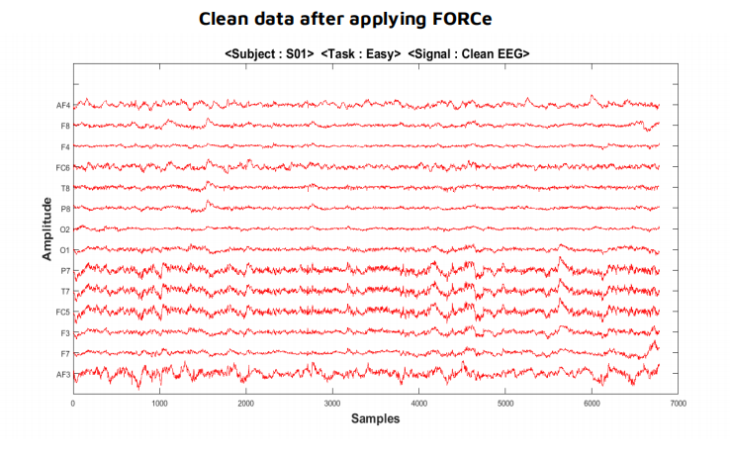
Dataset
Source: V. Anand, S. Sreeja, D. Samanta, An automated approach for task
evaluation using eeg signals, arXiv preprint arXiv:1911.02966 (2019)

Slide 12
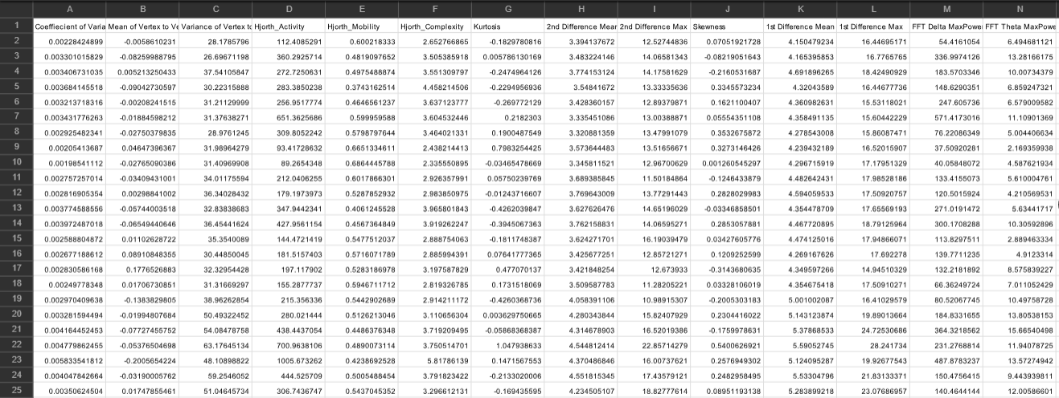
Feature Dataset
The data set provided 52 features in both the time and frequency domains.
Window of 1sec=128 bin size
It contains 7 statistical features, 10 derivative features, 4 interval or period features, 3 Hjorth parameters, 12 Frequency features, and 17 wavelet features

Slide 13
Feature Selection
The p-value is the measure of the probability of belonging to one class. We use a p-value for each feature extracted; if the p-value is less the feature will yield better results during classification .
Based on the p-value, the top 57% of the features of the entire data set is being selected.

Slide 14
Classifiers
Algorithms used
k-Nearest Neighbours (k-NN)
Decision Tree Classifier
Support Vector Machine (SVM)- Linear
Support Vector Machine (SVM)- Radial Basis Function
Random Forest

Slide 15
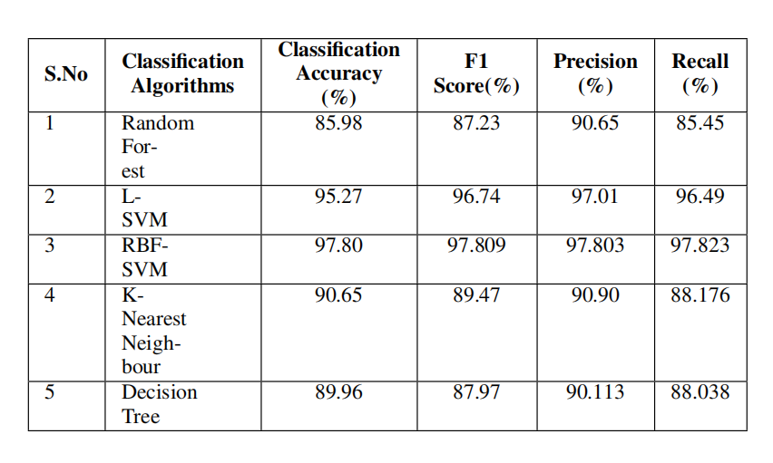
Accuracy Metrics
Source: Author

Slide 16
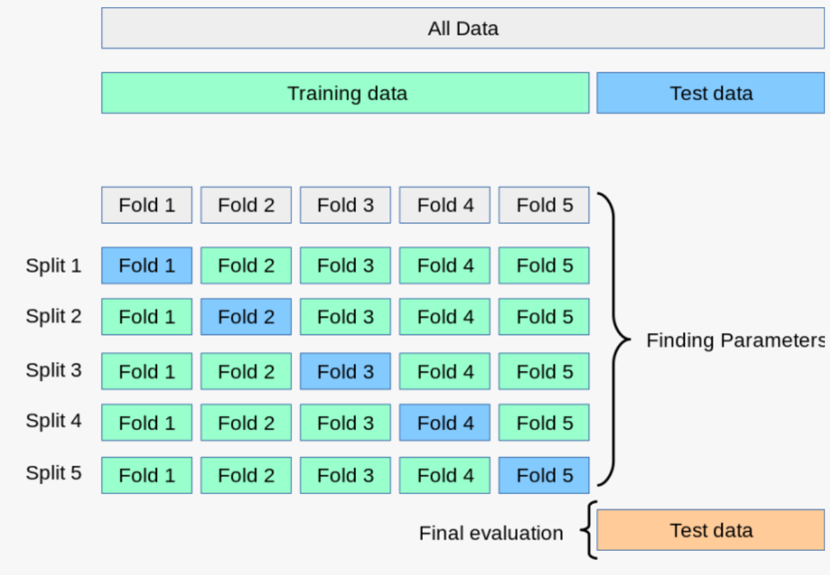
K-fold Cross Validation-mean accuracy
Step 1: Mix the dataset randomly
Step 2: Separate the dataset into K groups (10)
Step 3: For each group, do the following operations
a. Separate train and Test data
b. Fit into a model and evaluate test score
c. Retain the score and discard the model
Step 4: Take mean of all the accuracy scores for each algorithms
source: https://www.pngitem.com/middle/JhbRob_images-grid-search-cross-validation-k-fold-cross/

Slide 17
Mean vs Test Accuracy
Source: Author

Slide 18
Conclusion and Future Work
Different modalities used to detect cognitive workload have been discussed. It is shown how Eye-tracking, EEG sensors, and smart wearable are used.
An open-source dataset is used for experimentation. Support Vector Machine with RBF kernel has the highest accuracy of 97.47% for this dataset
EEG, eye-tracking and smart wearables all proved to be effective for mental cognition estimation.
Physical experiments needs to be conducted to determine the efficacy. The open-source dataset may have experimenter bias present. Number of subjects can be increased to increase variance.

Slide 19

Thank you!

Slide 20
Zagermann, J., Pfeil, U. and Reiterer, H., 2016, October. Measuring cognitive load using eye tracking technology in visual computing. In Proceedings of the sixth workshop on beyond time and errors on novel evaluation methods for visualization (pp. 78-85).
Chen, F., Zhou, J., Wang, Y., Yu, K., Arshad, S.Z., Khawaji, A. and Conway, D., 2016. Robust multimodal cognitive load measurement (pp. 13-32). Cham: Springer.
Sweller, J., 1988. Cognitive load during problem solving: Effects on learning. Cognitive science, 12(2), pp.257-285.
Hart, S.G. and Staveland, L.E., 1988. Development of NASA-TLX (Task Load Index): Results of empirical and theoretical research. In Advances in psychology (Vol. 52, pp. 139-183). North-Holland.
Fridman, L., Reimer, B., Mehler, B. and Freeman, W.T., 2018, April. Cognitive load estimation in the wild. In Proceedings of the 2018 chi conference on human factors in computing systems (pp. 1-9).
Vukovic, M., Stolar, M. and Lech, M., 2021. Cognitive Load Estimation From Speech Commands to Simulated Aircraft. IEEE/ACM Transactions on Audio, Speech, and Language Processing, 29, pp.1011-1022.
Biswas, P., Dutt, V. and Langdon, P., 2016. Comparing ocular parameters for cognitive load measurement in eye-gaze-controlled interfaces for automotive and desktop computing environments. International Journal of Human-Computer Interaction, 32(1), pp.23-38.
He, X., Wang, L., Gao, X. and Chen, Y., 2012, July. The eye activity measurement of mental workload based on basic flight task. In IEEE 10th International Conference on Industrial Informatics (pp. 502-507). IEEE.
Mallick, R., Slayback, D., Touryan, J., Ries, A.J. and Lance, B.J., 2016, October. The use of eye metrics to index cognitive workload in video games. In 2016 IEEE Second Workshop on Eye Tracking and Visualization (ETVIS) (pp. 60-64). IEEE.
Borys, M., Tokovarov, M., Wawrzyk, M., Wesołowska, K., Plechawska-Wójcik, M., Dmytruk, R. and Kaczorowska, M., 2017, March. An analysis of eye-tracking and electroencephalography data for cognitive load measurement during arithmetic tasks. In 2017 10th International Symposium on Advanced Topics in Electrical Engineering (ATEE) (pp. 287-292). IEEE.
Wang, Q., Yang, S., Liu, M., Cao, Z. and Ma, Q., 2014. An eye-tracking study of website complexity from cognitive load perspective. Decision support systems, 62, pp.1-10.
Keskin, M., Ooms, K., Dogru, A.O. and De Maeyer, P., 2020. Exploring the cognitive load of expert and novice map users using EEG and eye tracking. ISPRS International Journal of Geo-Information, 9(7), p.429.
Krejtz, K., Duchowski, A.T., Niedzielska, A., Biele, C. and Krejtz, I., 2018. Eye tracking cognitive load using pupil diameter and microsaccades with fixed gaze. PloS one, 13(9), p.e0203629.
Mallick, R., Slayback, D., Touryan, J., Ries, A.J. and Lance, B.J., 2016, October. The use of eye metrics to index cognitive workload in video games. In 2016 IEEE Second Workshop on Eye Tracking and Visualization (ETVIS) (pp. 60-64). IEEE.
Anderson, E.W., Potter, K.C., Matzen, L.E., Shepherd, J.F., Preston, G.A. and Silva, C.T., 2011, June. A user study of visualization effectiveness using EEG and cognitive load. In Computer graphics forum (Vol. 30, No. 3, pp. 791-800). Oxford, UK: Blackwell Publishing Ltd.
Kirschner, P.A., Sweller, J., Kirschner, F. and Zambrano R, J., 2018. From cognitive load theory to collaborative cognitive load theory. International Journal of Computer-Supported Collaborative Learning, 13(2), pp.213-233.
Chaouachi, M. and Frasson, C., 2010, June. Exploring the relationship between learner EEG mental engagement and affect. In International Conference on Intelligent Tutoring Systems (pp. 291-293). Springer, Berlin, Heidelberg.
Lan, T., Erdogmus, D., Adami, A., Mathan, S. and Pavel, M., 2007. Channel selection and feature projection for cognitive load estimation using ambulatory EEG. Computational intelligence and neuroscience, 2007.
Mills, C., Fridman, I., Soussou, W., Waghray, D., Olney, A.M. and D'Mello, S.K., 2017, March. Put your thinking cap on: detecting cognitive load using EEG during learning. In Proceedings of the seventh international learning analytics & knowledge conference (pp. 80-89).
Dan, A. and Reiner, M., 2017. EEG-based cognitive load of processing events in 3D virtual worlds is lower than processing events in 2D displays. International Journal of Psychophysiology, 122, pp.75-84.
McDonald, N.J. and Soussou, W., 2011, August. Quasar's qstates cognitive gauge performance in the cognitive state assessment competition 2011. In 2011 Annual International Conference of the IEEE Engineering in Medicine and Biology Society (pp. 6542-6546). IEEE.
Salfinger, A., 2020, September. Deep learning for cognitive load monitoring: A comparative evaluation. In Adjunct Proceedings of the 2020 ACM International Joint Conference on Pervasive and Ubiquitous Computing and Proceedings of the 2020 ACM International Symposium on Wearable Computers (pp. 462-467).
Mazher, M., Abd Aziz, A., Malik, A.S. and Amin, H.U., 2017. An EEG-based cognitive load assessment in multimedia learning using feature extraction and partial directed coherence. IEEE Access, 5, pp.14819-14829.
Daly, I., Scherer, R., Billinger, M. and Müller-Putz, G., 2014. FORCe: Fully online and automated artifact removal for brain-computer interfacing. IEEE transactions on neural systems and rehabilitation engineering, 23(5), pp.725-736.
Anand, V., Sreeja, S.R. and Samanta, D., 2019. An automated approach for task evaluation using EEG signals. arXiv preprint arXiv:1911.02966.
Buitinck, L., Louppe, G., Blondel, M., Pedregosa, F., Mueller, A., Grisel, O., Niculae, V., Prettenhofer, P., Gramfort, A., Grobler, J. and Layton, R., 2013. API design for machine learning software: experiences from the scikit-learn project. arXiv preprint arXiv:1309.0238.
Li, J., Cheng, K., Wang, S., Morstatter, F., Trevino, R.P., Tang, J. and Liu, H., 2017. Feature selection: A data perspective. ACM computing surveys (CSUR), 50(6), pp.1-45.
Rodriguez, J.D., Perez, A. and Lozano, J.A., 2009. Sensitivity analysis of k-fold cross validation in prediction error estimation. IEEE transactions on pattern analysis and machine intelligence, 32(3), pp.569-575.
Liaw, A. and Wiener, M., 2002. Classification and regression by randomForest. R news, 2(3), pp.18-22.
Wang, L. ed., 2005. Support vector machines: theory and applications (Vol. 177). Springer Science & Business Media.
Soucy, P. and Mineau, G.W., 2001, November. A simple KNN algorithm for text categorization. In Proceedings 2001 IEEE international conference on data mining (pp. 647-648). IEEE.
Loh, W.Y., 2011. Classification and regression trees. Wiley interdisciplinary reviews: data mining and knowledge discovery, 1(1), pp.14-23.
Chang, C.C., 2011. " LIBSVM: a library for support vector machines," ACM Transactions on Intelligent Systems and Technology, 2: 27: 1--27: 27, 2011. http://www. csie. ntu. edu. tw/~ cjlin/libsvm, 2.
Tervonen, J., Pettersson, K. and Mäntyjärvi, J., 2021. Ultra-short window length and feature importance analysis for cognitive load detection from wearable sensors. Electronics, 10(5), p.613.
Salfinger, A., 2020, September. Deep learning for cognitive load monitoring: A comparative evaluation. In Adjunct Proceedings of the 2020 ACM International Joint Conference on Pervasive and Ubiquitous Computing and Proceedings of the 2020 ACM International Symposium on Wearable Computers (pp. 462-467).
Li, X. and De Cock, M., 2020, September. Cognitive load detection from wrist-band sensors. In Adjunct Proceedings of the 2020 ACM International Joint Conference on Pervasive and Ubiquitous Computing and Proceedings of the 2020 ACM International Symposium on Wearable Computers (pp. 456-461).
Barua, S., Ahmed, M.U. and Begum, S., 2020. Towards intelligent data analytics: A case study in driver cognitive load classification. Brain sciences, 10(8), p.526.
Gjoreski, M., Mahesh, B., Kolenik, T., Uwe-Garbas, J., Seuss, D., Gjoreski, H., Luštrek, M., Gams, M. and Pejović, V., 2021. Cognitive Load Monitoring With Wearables–Lessons Learned From a Machine Learning Challenge. IEEE Access, 9, pp.103325-103336.
Gevins, A., Smith, M.E., McEvoy, L. and Yu, D., 1997. High-resolution EEG mapping of cortical activation related to working memory: effects of task difficulty, type of processing, and practice. Cerebral cortex (New York, NY: 1991), 7(4), pp.374-385.
Saha, A., Minz, V., Bonela, S., Sreeja, S.R., Chowdhury, R., Samanta, D. (2018). Classification of EEG Signals for Cognitive Load Estimation Using Deep Learning Architectures. In: Tiwary, U. (eds) Intelligent Human Computer Interaction. IHCI 2018. Lecture Notes in Computer Science(), vol 11278. Springer, Cham. https://doi.org/10.1007/978-3-030-04021-5_6
P. Zarjam, J. Epps and F. Chen, "Spectral EEG featuresfor evaluating cognitive load," 2011 Annual International Conference of the IEEE Engineering in Medicine and Biology Society, 2011, pp. 3841-3844, doi: 10.1109/IEMBS.2011.6090954.
Abásolo, D., Hornero, R., Gómez, C., García, M. and López, M., 2006. Analysis of EEG background activity in Alzheimer's disease patients with Lempel–Ziv complexity and central tendency measure. Medical engineering & physics, 28(4), pp.315-322.
Peng, C.K., Havlin, S., Stanley, H.E. and Goldberger, A.L., 1995. Quantification of scaling exponents and crossover phenomena in nonstationary heartbeat time series. Chaos: an interdisciplinary journal of nonlinear science, 5(1), pp.82-87.
Kuo, C.E. and Liang, S.F., 2011, November. Automatic stage scoring of single-channel sleep EEG based on multiscale permutation entropy. In 2011 IEEE Biomedical Circuits and Systems Conference (BioCAS) (pp. 448-451). IEEE.
Doma, V. and Pirouz, M., 2020. A comparative analysis of machine learning methods for emotion recognition using EEG and peripheral physiological signals. Journal of Big Data, 7(1), pp.1-21.
Maswanganyi, C., Tu, C., Owolawi, P. and Du, S., 2018, December. Discrimination of Motor Imagery Task using Wavelet Based EEG Signal Features. In 2018 International Conference on Intelligent and Innovative Computing Applications (ICONIC) (pp. 1-4). IEEE.
Delimayanti, M.K., Purnama, B., Nguyen, N.G., Faisal, M.R., Mahmudah, K.R., Indriani, F., Kubo, M. and Satou, K., 2020. Classification of brainwaves for sleep stages by high-dimensional FFT features from EEG signals. Applied Sciences, 10(5), p.1797.
Alomari, M.H., Samaha, A. and AlKamha, K., 2013. Automated classification of L/R hand movement EEG signals using advanced feature extraction and machine learning. arXiv preprint arXiv:1312.2877.
Dai, M., Zheng, D., Na, R., Wang, S. and Zhang, S., 2019. EEG classification of motor imagery using a novel deep learning framework. Sensors, 19(3), p.551.
Bălan, O., Moise, G., Moldoveanu, A., Leordeanu, M. and Moldoveanu, F., 2019. Fear level classification based on emotional dimensions and machine learning techniques. Sensors, 19(7), p.1738.
Link: https://drive.google.com/drive/folders/1zyXO-LXN4nTjpbhXkyfS7hj_QwUn8mvL

Slide 21


